Slide 1

Deloitte Hiring Exercise
Dan Logsdon 10/19/2020

Slide 2
Assumptions
Since the provided data had significant quality issues and the questions were ambiguous in some cases, the following assumptions were made:
Age values less than 0 were invalid. Zero age was included, as the categories in the instruction specified 0-14 age range.
Any string characters that did not follow the general data pattern were erroneous (e.g., “#”).
The net time was a more appropriate comparison metric for race time since this is the officially recorded time. This metric was used for Q1, Q3, and Q4 per the answer to the FAQ.
The age categories for divisions were “0-14”, “15-19”, and then 10-year increments thereafter.
The male and female race time were significantly different (as indicated by their means), so these data were analyzed independently for accurate results.
The “Race Results” for Q4 is the net race time. Another way to analyze this would be to look at the average place (e.g. 1st place) by division; however, this is not as accurate as the official race times, and no significant statistical difference were observed when analyzed by this metric.
While there are certain values missing in some columns (e.g., Hometown) these records were not dropped because they do not affect the analyses.

Slide 3
Methodology
The data file representing 2006 Pikes Peak 10K Race was converted from a text file to csv in Excel and cleaned using python scripts. The major edits to the files were:
Combined the Male and Female datasets into one dataset with a Gender key to keep track of the original files
Split the “Div/Tot” variable into two separate variables for analysis
Removed extra “.” characters in the “Hometown” variable
Dropped extra “#” and “*” characters from the “Net Tim” variable
Dropped any non-numeric characters from the beginning of “Gun Tim” variable
Converted all time variable from “HH:MM:SS” format into minutes for analysis
Created new division variable since many errors were observed in the “Div/Tot” data
Dropped records with age less than 0, as this is not possible
Checked for NaN values in time variables; however, none were observed.
Checked for duplicate record values by bib number; however, none were observed.
For mean comparisons, the 95% confidence interval was determined by either the normal approximation to the binomial distribution or 2-sided t-test.
The lengths of time taken for this exercise were as follows:
Cleaning Data ~ 2 hours
Analysis ~ 0.5 hours
Visualization/PowerPoint ~ 0.5 hours

Slide 4
Question One
Table 1. Net Race Time Statistics by Gender for all Runners (Minutes)
Results:
For all statistics, the net race time was greater for females than males. This was confirmed statistically by mean comparison in the next slide.
This indicates that male and female race times should be analyzed independently.
Statistic | Male | Female
Mean | 52.12 | 58.46
Median | 51.36 | 57.83
Mode | 35.47 | 46.52
Range | 28.78-100.63 | 32.97-106.82
Note: Based on the method of rounding, the mode could change. In this case, values were kept as floating-point precision values for greater accuracy.

Slide 5
Question TWO
Figure 1. Mean Gun and Net Race Times by Gender for all Runners (Minutes)
Results:
For both male and female runners, the mean net time was less than the mean gun time.
Female mean net and gun times were both greater than male mean net and gun times.
Note: error bars indicate the 95% confidence interval using the 2-sided t-test

Slide 6
Question Three
Figure 2. Mean Net Race Time for Top 10% of 40-49 Age Runner Division
Results:
Chis Doe’s time is 11.67 minutes greater than the mean of the top 10% of runners in the 40-49 division.
Chris Doe’s time is also 8.35 minutes greater than the slowest runner in the top 10% of runners in the 40-49 division.
Min: 33.10
Max: 41.37
Note: error bars indicate the 95% confidence interval using the 2-sided t-test

Slide 7
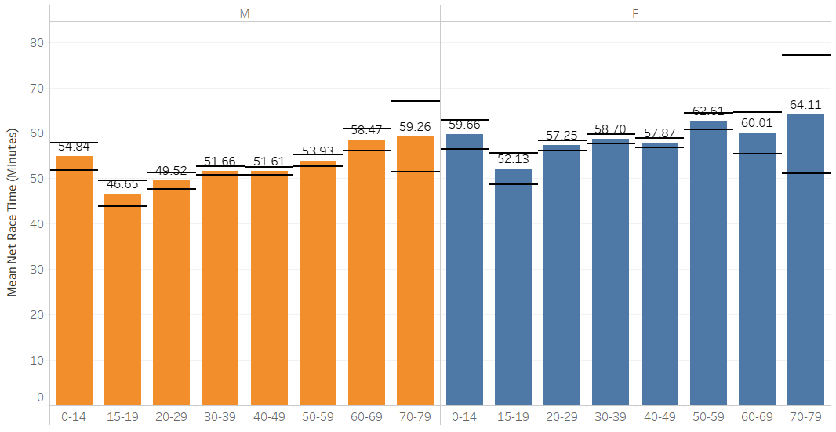
Question Four
Figure 3. Mean Net Race Time by Age Division and Gender
Results:
For Male runners, older racers generally had statistically slower race times than younger runners (e.g, 15-19 vs. 60-69).
For Female runners, older runners and younger runners did not have as statistically different race times except in the 15-19 and 50-59 age divisions.
For both male and female runners, the 0-14 age group was slower than the 15-19 age group.
Male
Female
Note: error bars indicate the 95% confidence interval using the normal approximation to the binomial distribution. The Male 80-89 division was excluded due to low counts (n=2)

Slide 8
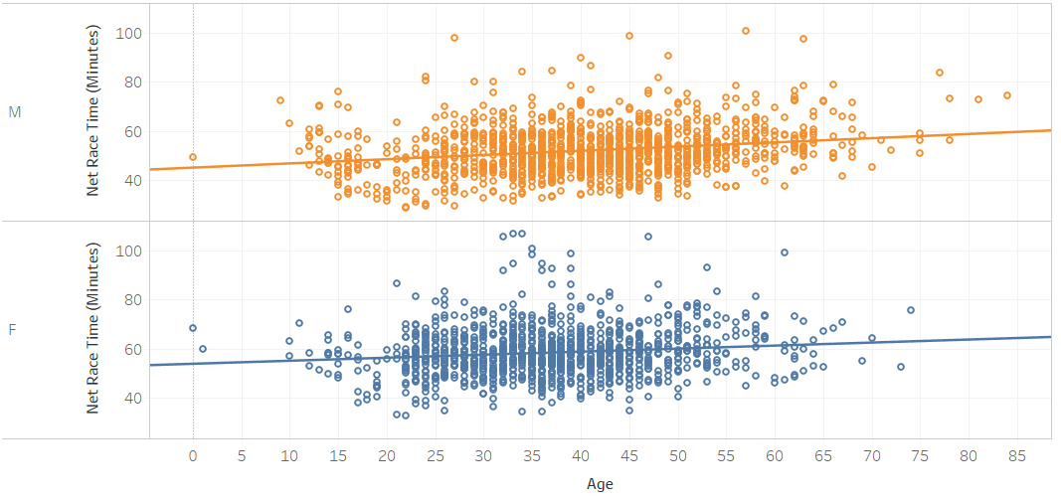
Question Four
Figure 4. Correlation of Age and Net Race Time
Results:
The previous slide results are confirmed with linear correlation. Greater age is highly linearly correlated with slower race times for both Male and Female runners.
Male
P < 0.001
R² = 0.047
Female
P < 0.001
R² = 0.017
Note: P<0.05 indicates statistically significant slope. R² value indicates the goodness of fit.

Slide 9
Thank you!

